Slide 1
Building Violations
Early Insights
Team C
Youxuan Ma
Guanxi Li
Heyang Yu
Yuzhe Jiang
Jian Xie

Slide 2
Data Cleaning and Preprocessing
Remove columns with substantial missing data to reduce interference from irrelevant data.
Delete rows with missing information to ensure all data are valid.
Sort the dataset to make it more structured and organized.

Slide 3
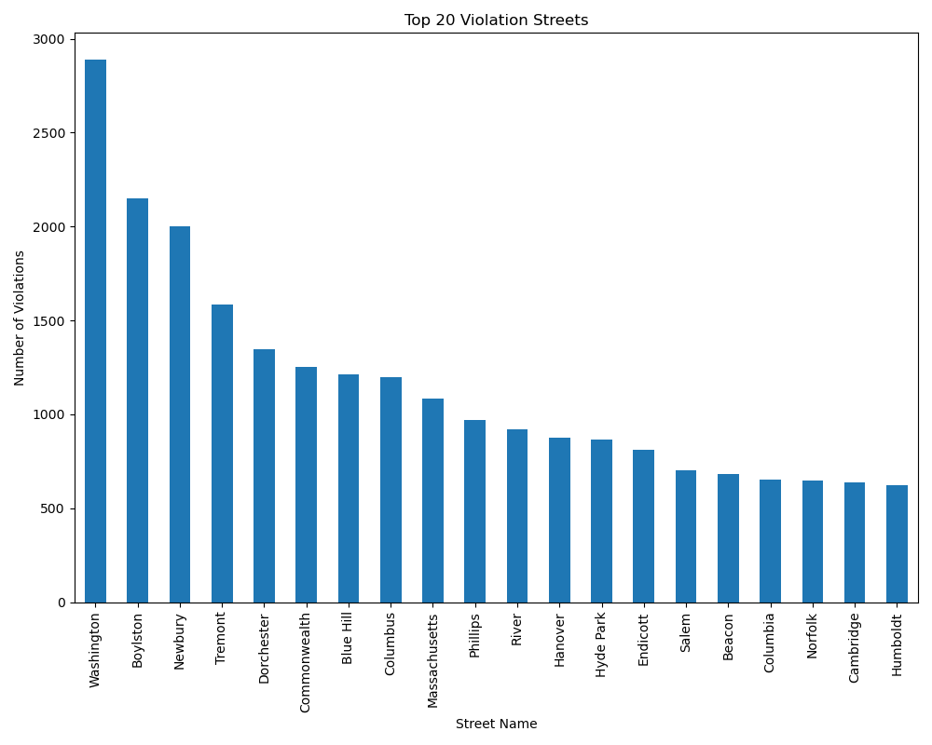
Top 20 Streets with the Highest Number of Violations
By counting the occurrences of `violation_street` entries, this chart ranks the top 10 streets with the highest number of reported violations. This visualization helps to pinpoint hotspots of non-compliance within the area, shedding light on where resources might be best allocated to address these issues.

Slide 4
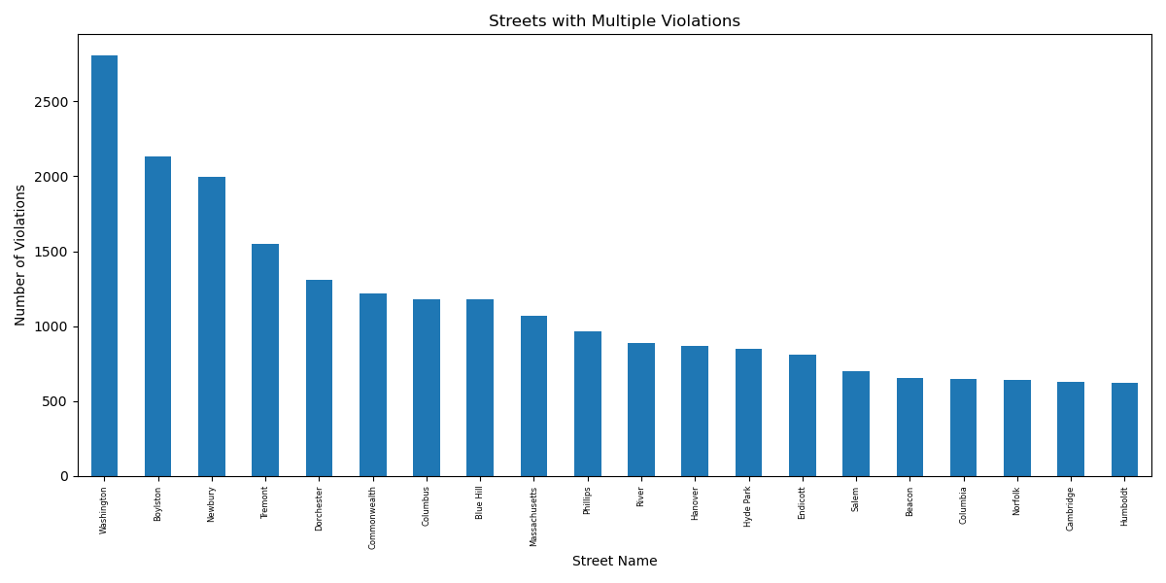
Data Analysis: Streets with Repeated Violations
This visualization identifies streets with recurring violations by aggregating records based on the `sam_id`, a unique identifier for properties. It filters for `sam_id` occurrences greater than two and then counts how frequently each corresponding street is mentioned. This graph highlights streets prone to repeated violations, suggesting areas that might benefit from targeted enforcement or preventative measures.

Slide 5
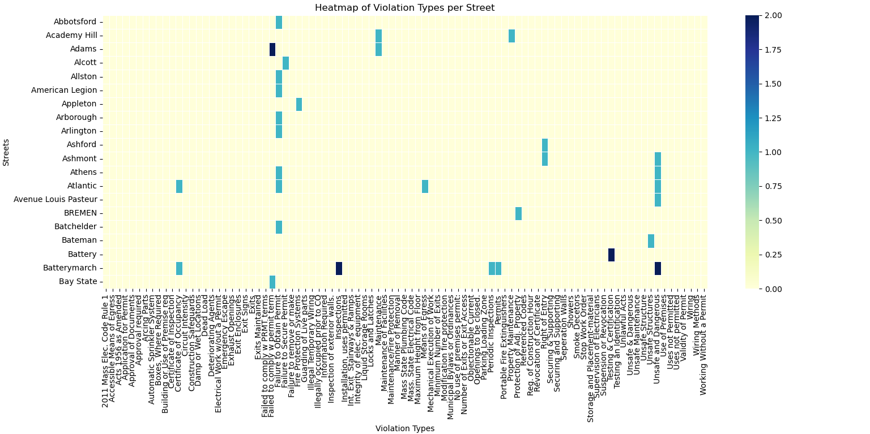
Heatmap of Violation Types
Utilizing the `description` field, this heat map displays the frequency of each type of violation across different streets. It reveals patterns in the prevalence of specific violations per street, providing insights into common compliance issues in certain areas. This information could guide targeted interventions or public awareness campaigns.

Slide 6
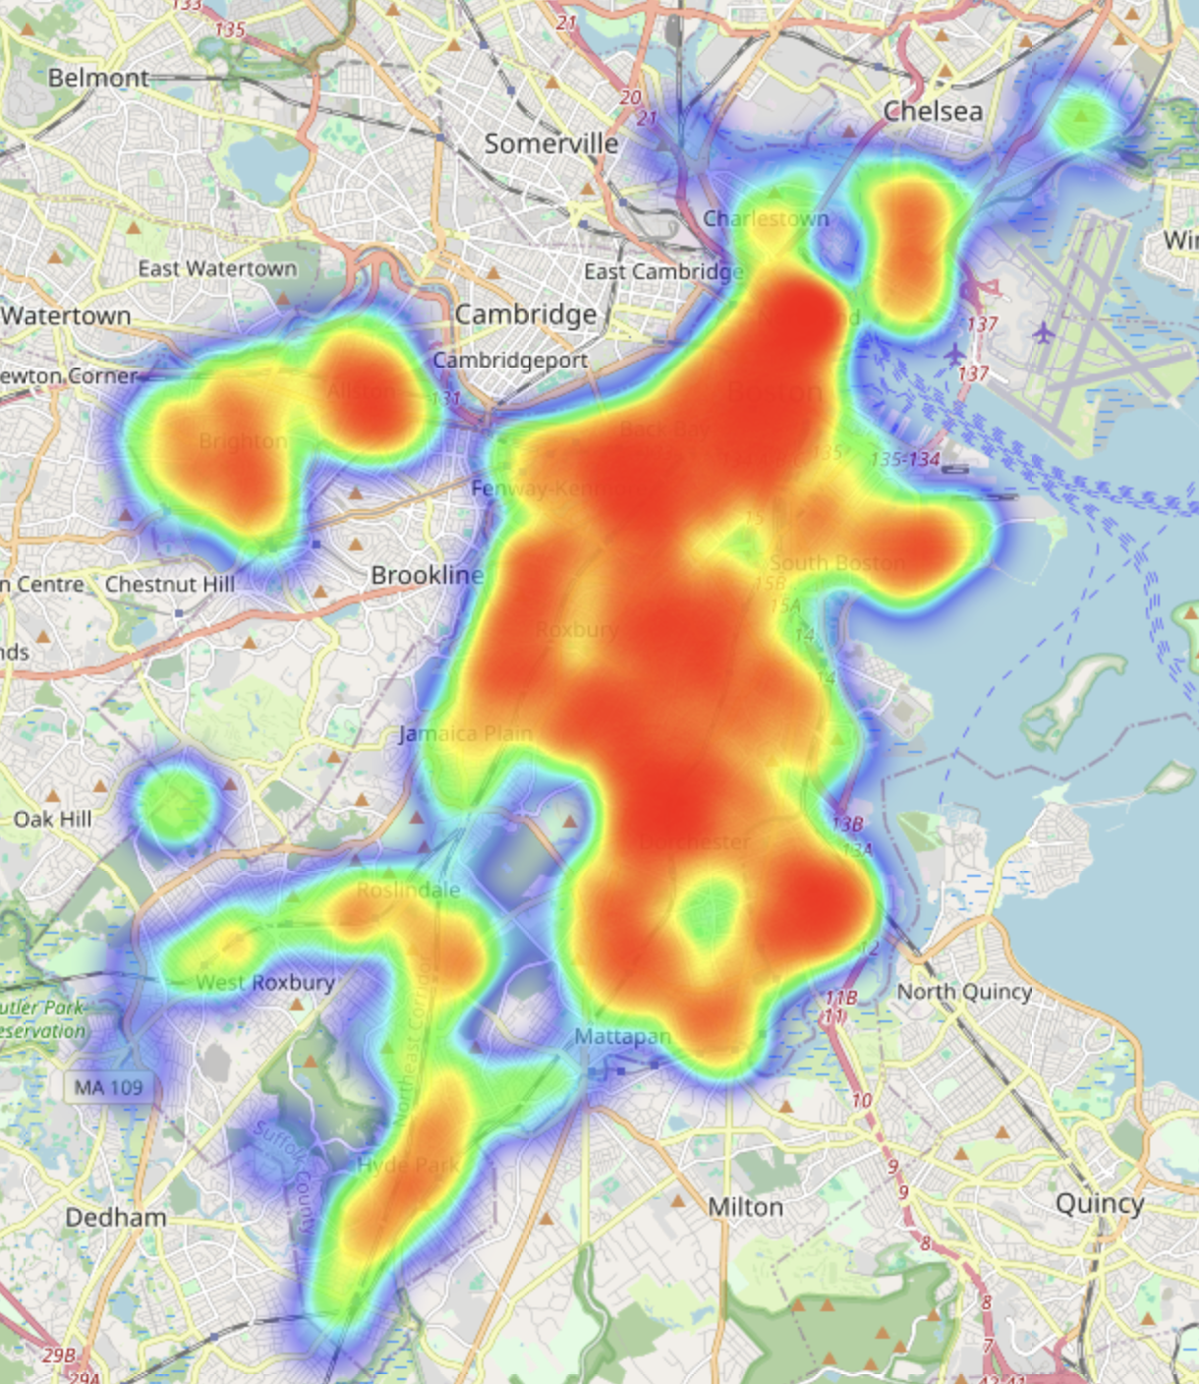
Heatmap
Based on the latitude and longitude of each record, this heatmap visualizes the concentration of violations in specific geographic areas. Areas with a higher density of violations appear more prominently, allowing for a quick visual assessment of which neighborhoods might be experiencing higher levels of non-compliance or other issues.

Slide 7
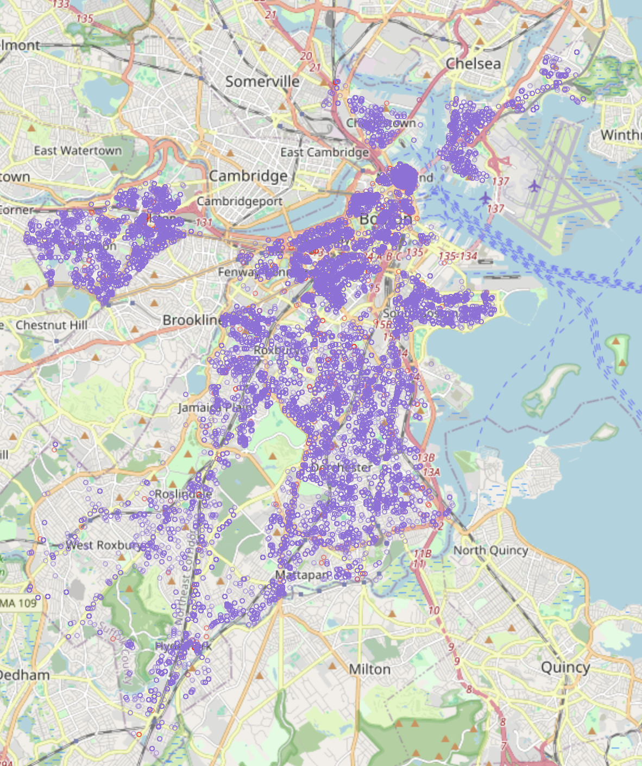
Boston Violations Map
This map marks the exact locations of recorded violations using the geographic coordinates provided in the dataset. It offers a detailed view of where violations are occurring within the city, enabling a granular analysis of problem areas. This visualization can be particularly useful for local authorities or urban planners looking to address specific issues or improve citywide compliance strategies.

Slide 8
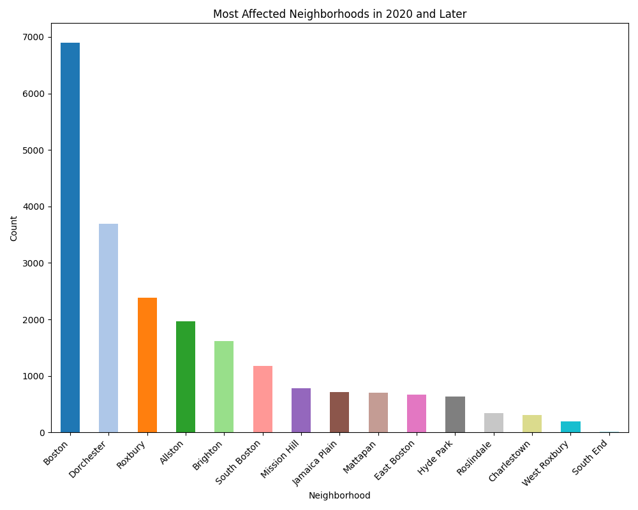
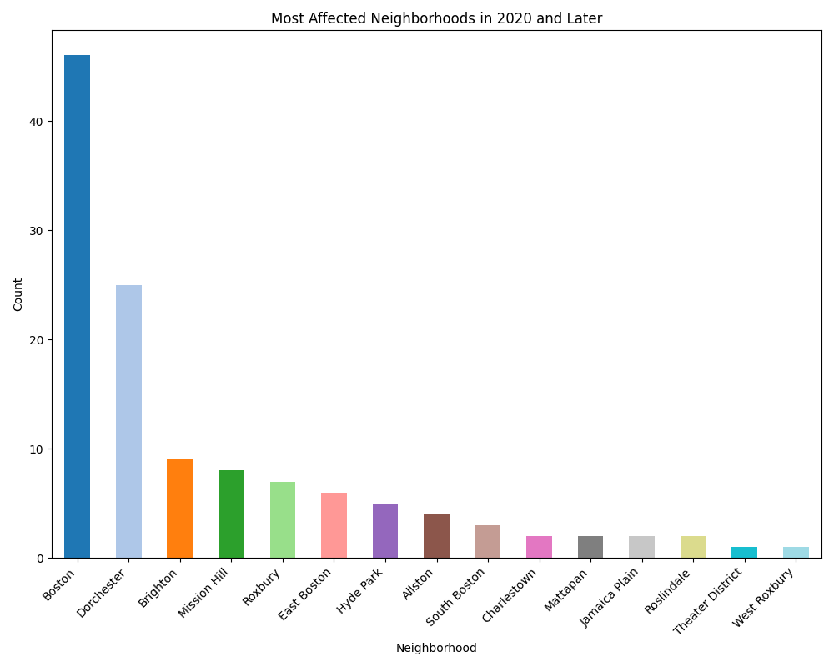
Most Affected Neighborhoods
These two charts count the ‘neighborhood’ column in the data from 2020 onwards for the ‘Building and Property Violations’ and ‘Public Work Violations’ datasets, respectively. The goal is to identify which neighborhoods have been most severely affected by violations in recent years.

Slide 9
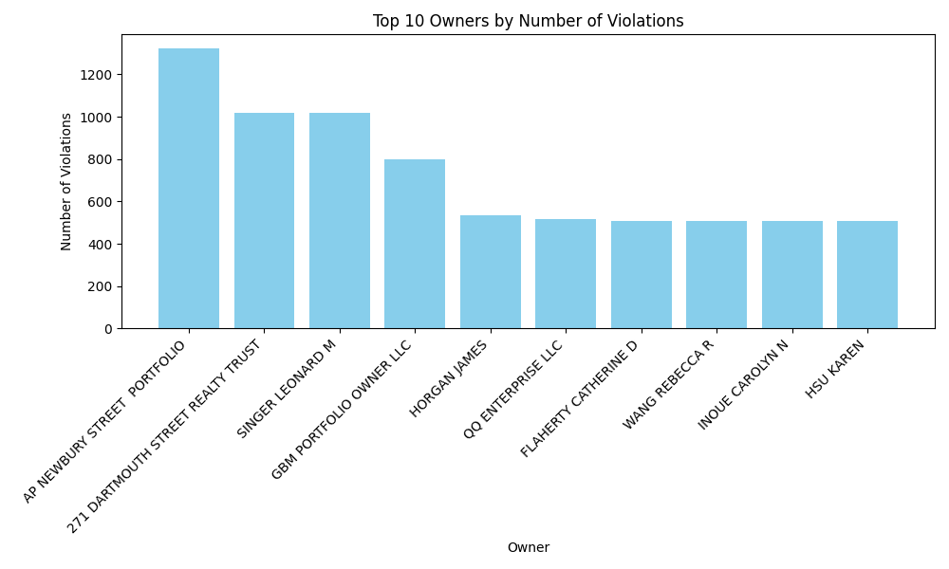
Landlords / Management with Most Violations
By merging the ST_NUM and ST_NAME columns from the Property Assessment dataset, along with the violation_stno, violation_street, and violation_suffix from the Building and Property Violations dataset, we have created full_address columns in both tables. Subsequently, by matching these datasets on full_address and tallying the OWNER column in the resulting matches, we are able to determine the number of violations attributed to each landlord/management entity. This analysis is instrumental in identifying and safeguarding against landlords with a history of violations, thereby protecting potential tenants from undesirable rental situations.

Slide 10
Future Plans
Schedule a meeting with the client
As of now, our project has not yet utilized the 311 datasets. However, we are poised to conduct further analysis and refinement on these datasets in the future, aiming to reduce any inherent biases and seamlessly integrate them into our ongoing work.
Answer all key questions

Slide 11
Q&A

Slide 12
Thank You!

